Slide 1



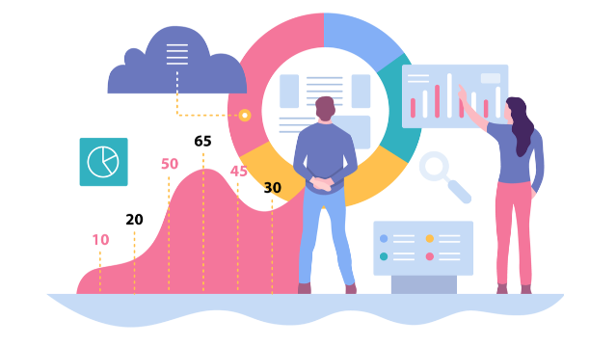
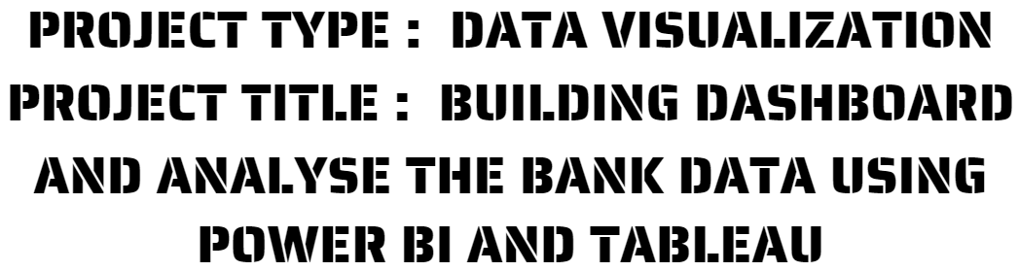


Slide 2

Introduction to Data analytics and data visualization
Introduction to POWER BI
Problem statement
Problem statement / objective
Literature review
POWER BI Dashboard
Introduction to TABLEAU
Tableau vs Power BI
TABLEAU Dashboard
Worklog
Target Audience
Reference

Slide 3


Data analytics refers to the process of examining and interpreting large volumes of data to uncover meaningful insights, patterns, and trends.
It involves various techniques and methodologies to extract valuable information from raw data,
ultimately enabling businesses and organizations to make informed decisions and drive strategic actions.​

Slide 4

01 Predictive data analytics
most commonly used category of data analytics. Businesses use predictive analytics to identify trends, correlations, and causation.
02 Prescriptive data analytics
Prescriptive analytics is where AI and big data combine to help predict outcomes and here is where the process of random testing comes.
03 Diagnostic data analytics
analyzing data from the past can serve an important purpose in guiding your business.
04 Descriptive data analytics
Descriptive analytics are the backbone of reporting—it’s impossible to have business intelligence (BI) tools and dashboards without it. It addresses basic questions of “how many, when, where, and what.”

Slide 5
01 Predictive data analytics
most commonly used category of data analytics. Businesses use predictive analytics to identify trends, correlations, and causation.
02 Prescriptive data analytics
Prescriptive analytics is where AI and big data combine to help predict outcomes and here is where the process of random testing comes.
03 Diagnostic data analytics
analyzing data from the past can serve an important purpose in guiding your business.
04 Descriptive data analytics
Descriptive analytics are the backbone of reporting—it’s impossible to have business intelligence (BI) tools and dashboards without it. It addresses basic questions of “how many, when, where, and what.”

Slide 6
01 Predictive data analytics
most commonly used category of data analytics. Businesses use predictive analytics to identify trends, correlations, and causation.
02 Prescriptive data analytics
Prescriptive analytics is where AI and big data combine to help predict outcomes and here is where the process of random testing comes.
03 Diagnostic data analytics
analyzing data from the past can serve an important purpose in guiding your business.
04 Descriptive data analytics
Descriptive analytics are the backbone of reporting—it’s impossible to have business intelligence (BI) tools and dashboards without it. It addresses basic questions of “how many, when, where, and what.”

Slide 7
01 Predictive data analytics
most commonly used category of data analytics. Businesses use predictive analytics to identify trends, correlations, and causation.
02 Prescriptive data analytics
Prescriptive analytics is where AI and big data combine to help predict outcomes and here is where the process of random testing comes.
03 Diagnostic data analytics
analyzing data from the past can serve an important purpose in guiding your business.
04 Descriptive data analytics
Descriptive analytics are the backbone of reporting—it’s impossible to have business intelligence (BI) tools and dashboards without it. It addresses basic questions of “how many, when, where, and what.”

Slide 8
Which involves :
Data Collection Data Cleaning and Preparation
Data Exploration Data Modelling and Analysis
Data Visualization and Presentation Decision-Making and Action
01 Predictive data analytics
most commonly used category of data analytics. Businesses use predictive analytics to identify trends, correlations, and causation.
02 Prescriptive data analytics
Prescriptive analytics is where AI and big data combine to help predict outcomes and here is where the process of random testing comes.
03 Diagnostic data analytics
analyzing data from the past can serve an important purpose in guiding your business.
04 Descriptive data analytics
Descriptive analytics are the backbone of reporting—it’s impossible to have business intelligence (BI) tools and dashboards without it. It addresses basic questions of “how many, when, where, and what.”

Slide 9

Microsoft Power BI is an interactive data visualization software product developed by Microsoft with a primary focus on business intelligence.

Slide 10

Background : you are a business analyst at JS Bank
Details : Bank owner has asked you to analyze the bank data and come up key insights and
observations which will help the bank roll new schemes to it's existing customers and also attract new customers.
Task : Build a dashboard and analyze the bank data to fulfil the Bank Owner's requirement.

Slide 11

Analyzing and visualizing in power bi
Abstract:
ETL stands for Extraction, Transformation and Loading. Initially we extract data from data source. Once data is extracted, we perform transformations on it as per requirements. Once transformations are over, we load data into data warehouse. It helps to analyze business data for taking business decisions. In this study, we present how ETL process in power BI works. Power BI is a business analytics service by Microsoft. ETL process connect, transform and visualize is presented in research paper to understand ETL process in power BI.
The objectives of research paper are:
1.To understand ETL process. 2.To demonstrate ETL process in power BI.
Research method:
Power BI is a collection of software services, apps and connectors that work together to turn our unrelated sources of data into coherent, visually immersive, and interactive insights. It is one of the powerful data analytics and visualization tool.

Slide 12
FINDINGS:
Sales data is as follows:
Regions – East, West, Central
Number of Representatives – 11
Items – Binder, Desk, Pen, Pen Set, Pencil
Total No of Units – 2121
Total Unit’s Cost – Rs. 873.27
Sales dataset was analyzed and visuals indicate that most of items are from Central region. Maximum number of units ordered are in April 2020.Items ordered in Central region are 24, West 6 and East 13. Percentage of items ordered from Central region is 55.81%, West is 13.95% and East is 30.23%.No. of units ordered, are maximum in April 2020 i.e. 162 and are minimum in June 2020 i.e. 5.Representative Jones has ordered maximum No. of 396 units and representative Thompson has ordered minimum No. of 89 units.
This concludes that, ETL converts raw data into structured data which is used in analysis. Companies use ETL to improve their productivity and they can analyze their business data using ETL for taking complex business decisions.

Slide 13
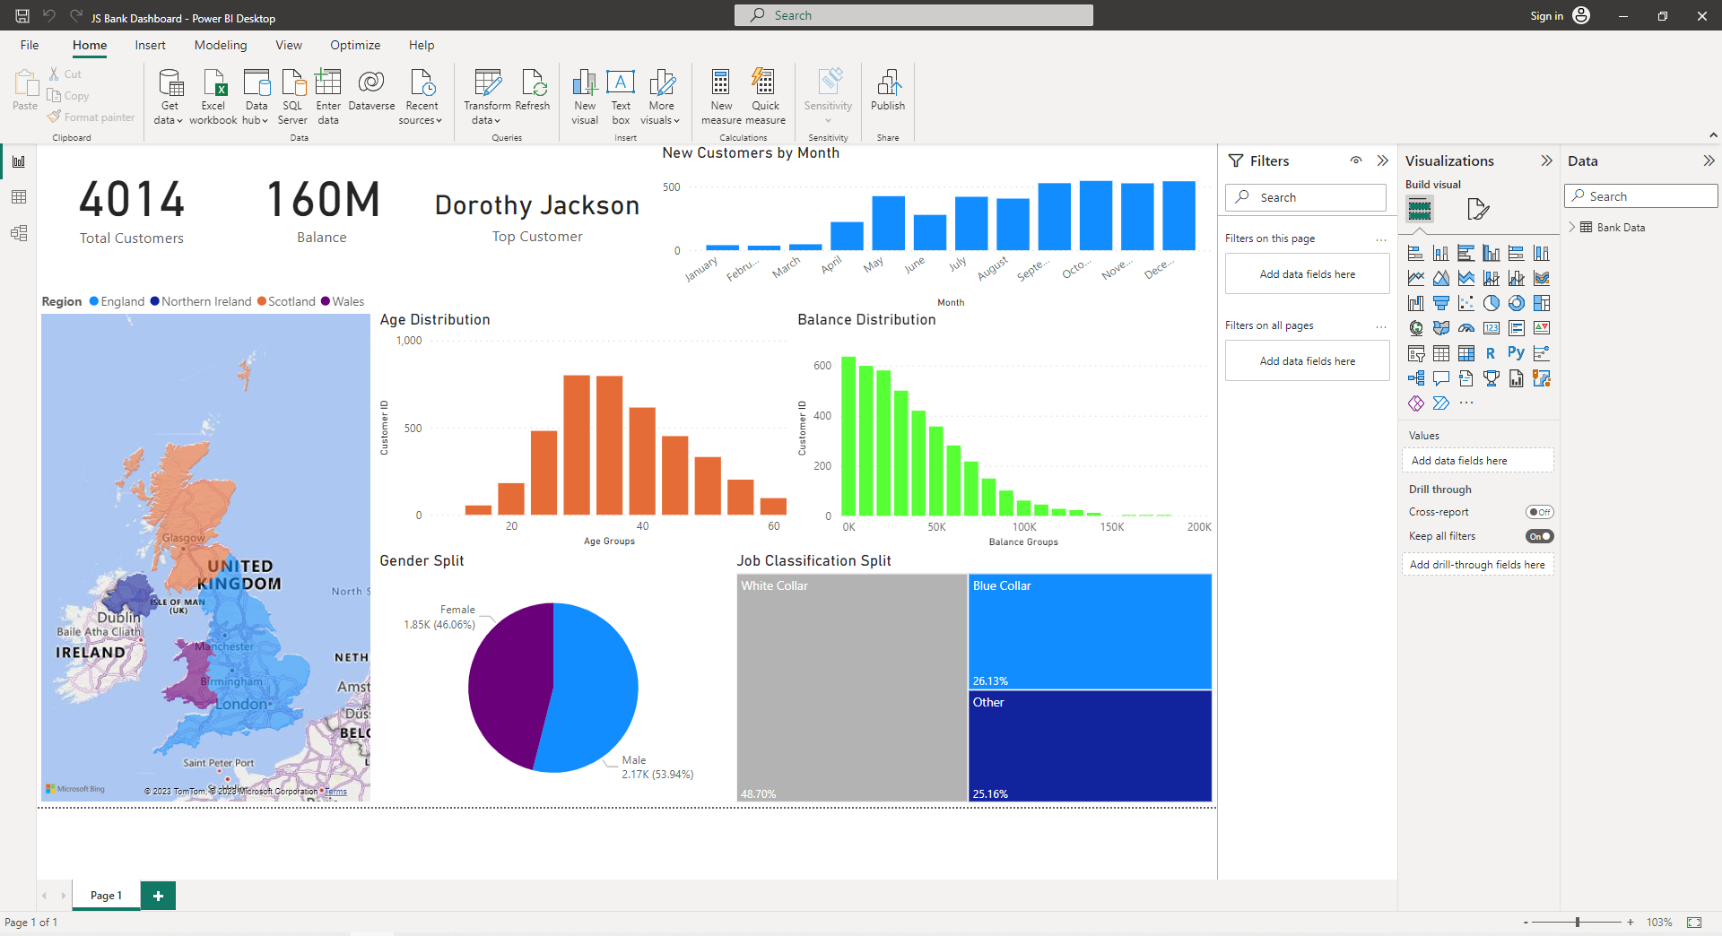

Slide 15
Count of customer ID : total customers in the dataset
Field - customer ID : Mark as COUNT
As well as you can rename it. Let us make it as total customers.
Total balance of our entire bank
Field - balance : Mark as sum
To change it to whole number (159.62 to 160) format - data label - display unit to millions
and value decimal as zero.
Customer name of the customer having
highest balance
Field - Customer name
Filter - top one balance.

Slide 16
How many New customers were added per month
Column chart - data join into axis
At different months we need new customers by arranging it in ascending order.
By turning off the concatenate we see for every year before it was for per month only for one year.

Slide 17
location/region column
Legend - Region and change colors.

Slide 18
fill map for job classification
Value - customer ID
Group - job classification (one for white collar, blue one for other)

Slide 20
Gender split
Pie chart - total people by gender
Values -customer ID and also include the name male and female.

Slide 21
Tree map for job classification
Value - customer ID
Group - job classification (one for white callor, blue one for other)

Slide 23


TABLEAU
SALES DATA PROJECT

Slide 24
Tableau is helpful when you want a more detailed analysis of your business reports.

Slide 25
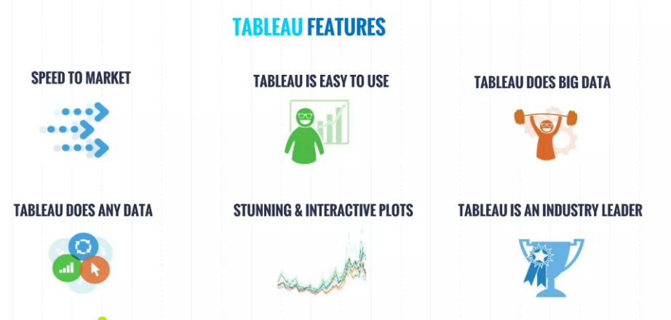

Slide 26
Problem statement
Create a dashboard of sales management
of global super store using tableau.
Segment by sales of profit
Sales by category
Region by sales
Sub category by profit

Slide 27
POWER BI
TABLEAU
CAN CONNECT TO WIDE RANGE OF DATA SOURCES INCLUDING CLOUD BASED DATABASES
IS MORE TIGHTLY INTEGRATED WITH MICROSOFT PRODUCT SUCH AS EXCEL SQL

Slide 28
POWER BI
TABLEAU
CAN CONNECT TO WIDE RANGE OF DATA SOURCES INCLUDING CLOUD BASED DATABASES
IS MORE TIGHTLY INTEGRATED WITH MICROSOFT PRODUCT SUCH AS EXCEL SQL

Slide 29
CONNECTING TO DATA
EXCEL
DATA BASE
CLOUD
SAVING AND PUBLISHING DATA SOURCES
A Data source can be saved which makes it easily available.
Or it can be published to tableau online or tableau server

Slide 30

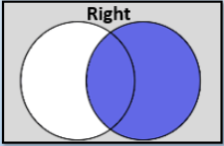
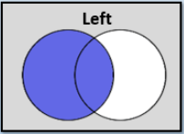
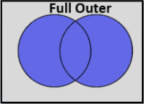
Joining data tables in Tableau
A Data source can be saved which makes it easily available.
Or it can be published to tableau online or tableau server

Slide 31
Joining data tables in Tableau
A) Inner Join
It combines only the common records from the tables. The Join tool has two input nodes, a left and a right part. Notice that it has three output nodes, the L / J / R ones, L standing for a Left Excluding Join, J = Inner Join and R = Right Excluding Join.
A Data source can be saved which makes it easily available.
Or it can be published to tableau online or tableau server

Slide 32
Joining data tables in Tableau
B) Right Join
A ‘Right Join’ returns all records from the second data table (Geography) and the matching records from the first table.
A Data source can be saved which makes it easily available.
Or it can be published to tableau online or tableau server

Slide 33
Joining data tables in Tableau
C) Left Join
This will include all records from the first table (Players) and all matching records from the second table.
A Data source can be saved which makes it easily available.
Or it can be published to tableau online or tableau server

Slide 34
Joining data tables in Tableau
D) Full Outer Join
This type of join returns all records
A Data source can be saved which makes it easily available.
Or it can be published to tableau online or tableau server

Slide 35
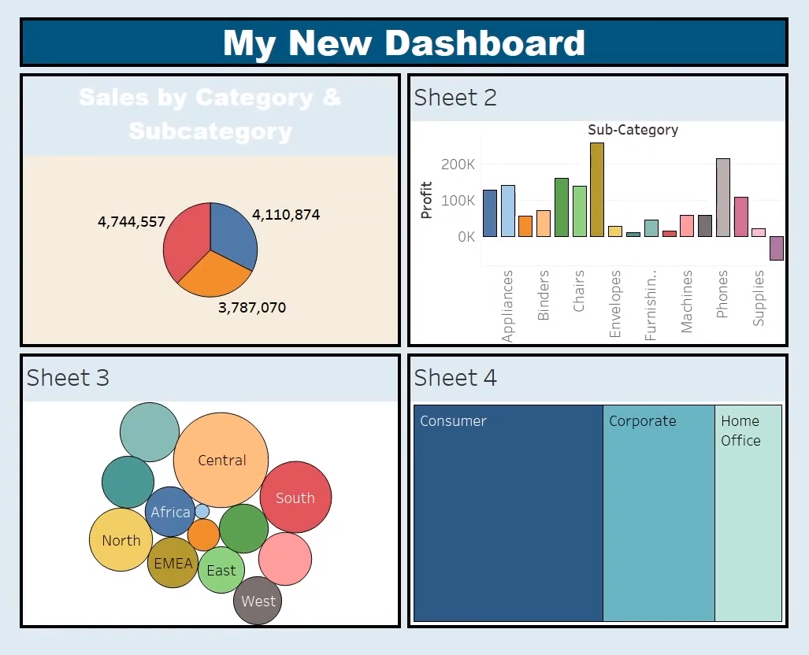
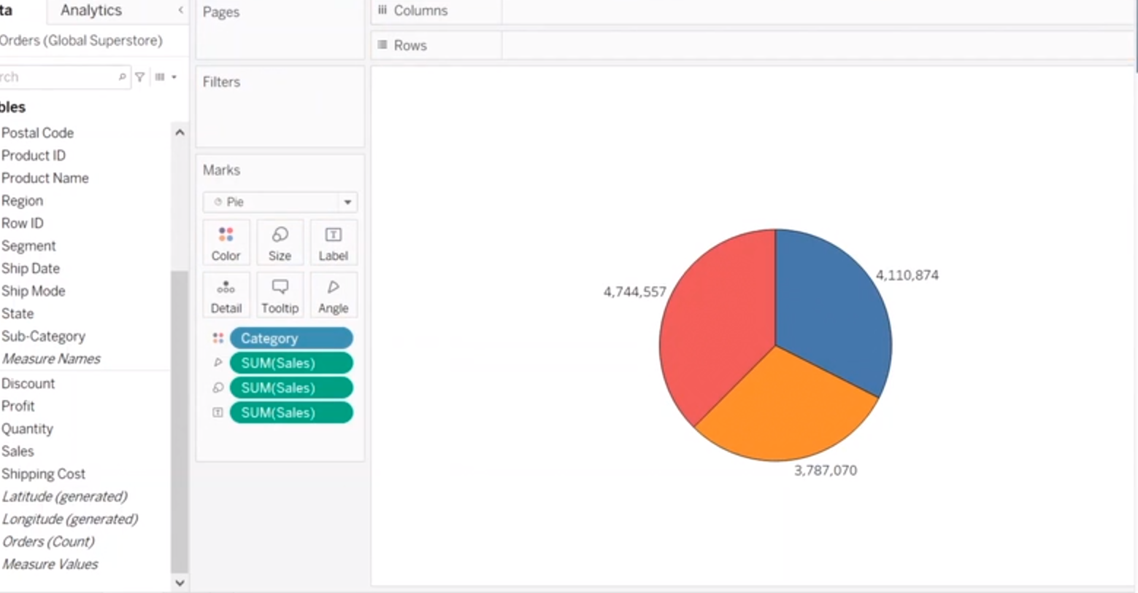

Slide 36
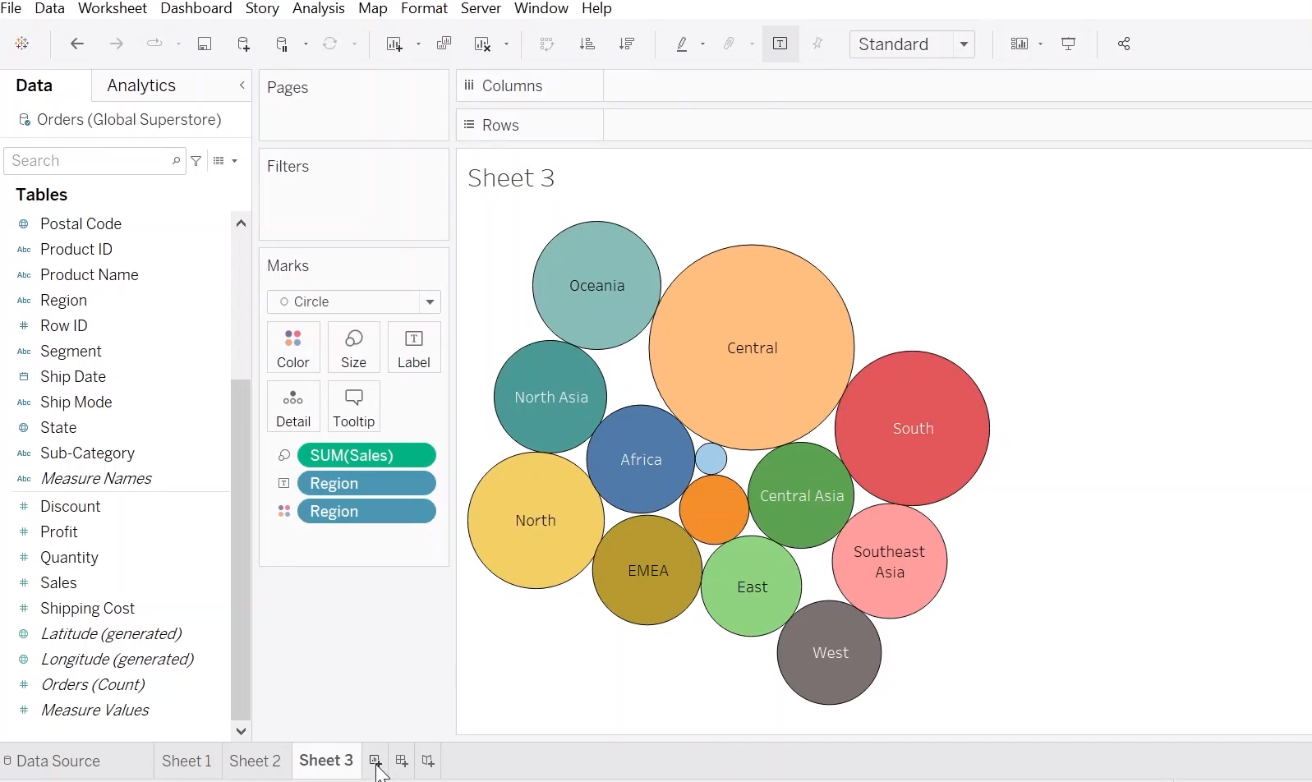
Sales by category
Pie chart
Border
Labels (formatted)

Slide 37
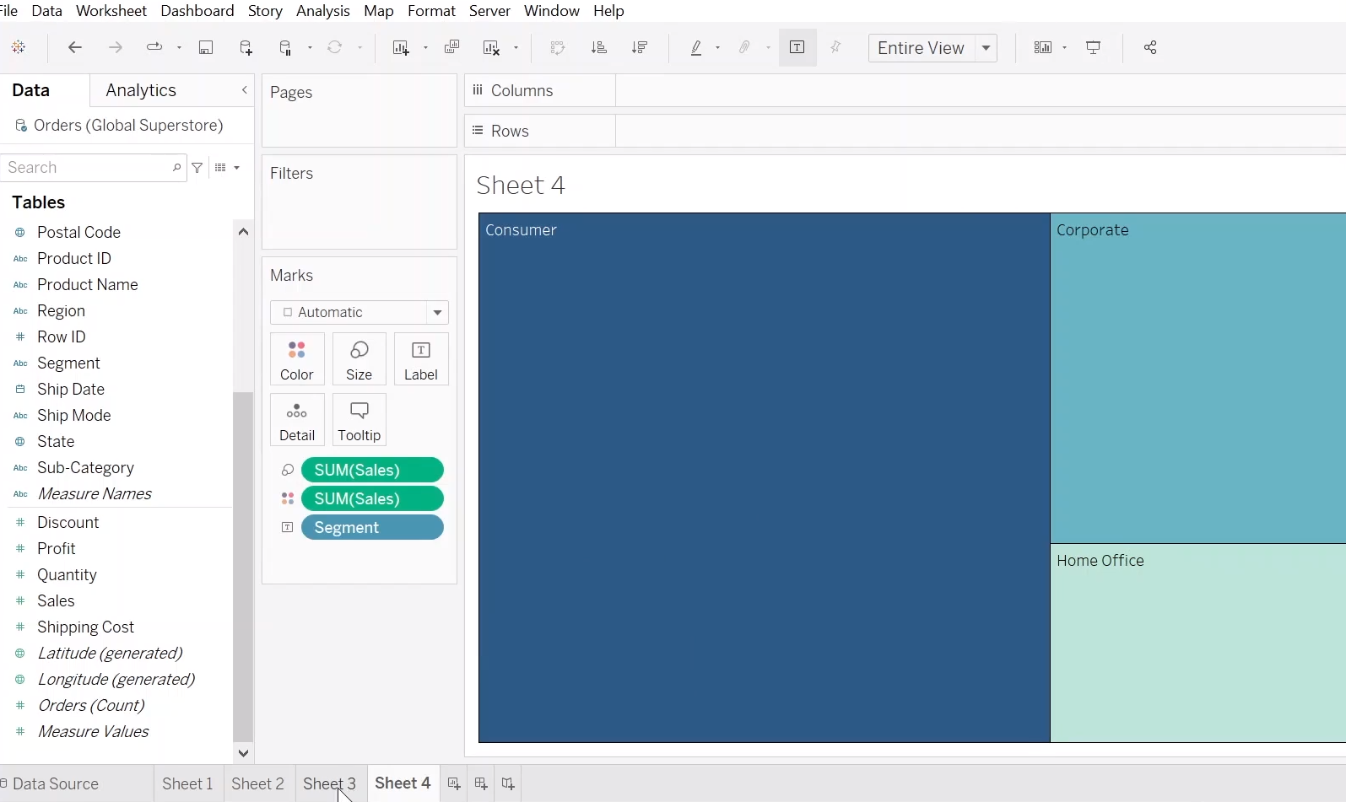
Region by sales
Bubble chart
boarder

Slide 38
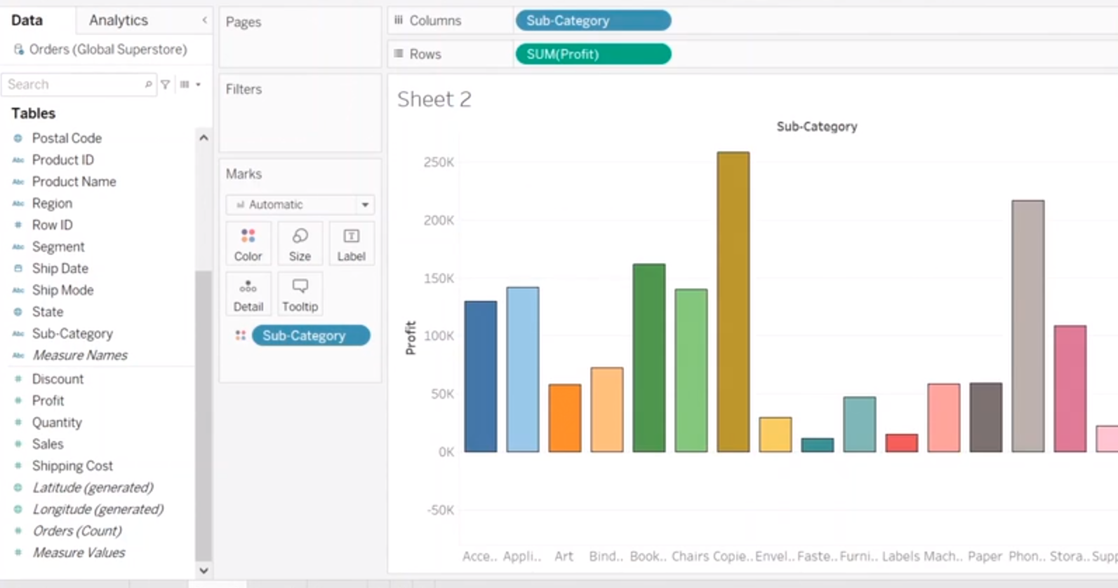
Segment by sales of profit
Tree map

Slide 39
Sub category by profit
Bar chart
Border
Sub category in color

Slide 41
DAY DATE TASK DONE
1 09.05.2023 Understanding the data
2 11.05.2023 Studying about data visualization
3 23.05.2023 Basic concepts of Power BI and Tableau
4 30.05.2023 Clean and transform data, and create relationships between tables.
5 31.05.2023 Data Preparation and Modelling
6 08.06.2023 Customize visualizations
7 13.06.2023 Data modelling techniques like calculated fields, hierarchies, and measures.
8 15.06.2023 Visualization Techniques
9 20.06.2023 Visualization Techniques
10 22.06.2023 Create various chart types, maps, and interactive dashboards
11 27.06.2023 Advanced Features
12 01.07.2023 sample projects
13 03.07.2023 sample projects
14 05.07.2023 sample projects

Slide 42
TARGET AUDIENCE :
Introduction
Dashboard Overview
Business Problem or Use Case
Data Sources and Transformation
Key Visualizations and Insights
Dashboard Interactivity and Filters
Performance and Scalability
Security and Sharing
Benefits and Impact
Conclusion

Slide 43
REFERENCE
SatKaur, Anuj Mehta, A Review Paper on Scope of ETL in retail domain: International Journal of Advance Research in Computer Science and Software Engineering. Volume 3, Issue 5, May 2013.
Sagar Bhujbal, Dhanesh Gite, Yadnesh Kadam, Bhushan Narkhede A New Database for Retail Domain using ETL System: International Journal of Advance Research in Computer Science and Mobile Computing. Volume 4, Issue 5, May 2015.
Preeti Dhanda, Neetu Sharma, Extract Transform Load Data with ETL Tools: International Journal of Advance Research in Computer Science, Volume 7, No. 3, May-June 2016.
Priyanshu Gupta, Data warehousing and ETL processes: An Explanatory Research: International Journal of Engineering Development and Research. Volume 4, Issue 4, 2016.
Qin Halnin, Jin Xianzhen, Zhang Xianrong, Research on Extract, Transform and Load (ETL) in Land and Resources star schema Data Warehouse: 2012 fifth International Symposium on Computational Intelligence and Design 2012

Slide 44
THANK YOU

